Slide 1

IST 597: Foundations of Data Privacy Re-identification: The trouble with naïve anonymization
February 7, 2022
Partial slide credit: Anna Squicciarini (PSU), Joe Near (UVM)

Slide 2
Logistics,
Groups, etc.
https://docs.google.com/document/d/1TYMT4HfcAcw4HR930UufaWkSO7xEWlQtc-32ma00ZVY/edit
Homework 2: released February 14; due February 28

Slide 3
Class Outline
Anonymity vs privacy
Naïve anonymization
Attacks on naïve anonymization
Hands-on; coding
Break & post to discussion (20 minutes)
Presentation – Covid & data privacy (30 minutes)
Introduce conceptual foundations of k-anonymity

Slide 4
What is anonymity?

Slide 5
Can you have anonymity but not privacy?
Can you have privacy but not anonymity?

Slide 6
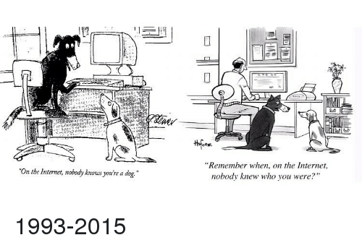
Identity, Privacy and Anonymity

Slide 7
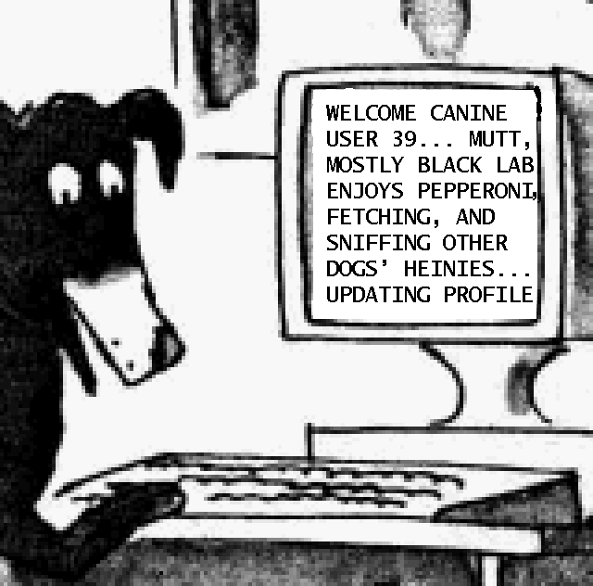

Slide 8
Anonymity

Slide 9
Privacy

Slide 10
Data workflow – and privacy
Limited release/ statistical aggregate
Collection limitation
Data Collection
Data Filtering/
Processing
Analysis
Publications/Usage
Anonymization/
Encryption
Privacy-preserving data analytics

Slide 11
When do data analytics violate privacy?
Analysis of data preserves data privacy if:
You learn something useful from the analysis
The analysis does not violate the privacy of any individual
An individual's privacy is violated if:
The analyst learns something about the individual that they did not know before the analysis took place (?)
Let’s take the next couple of slides to see if we are happy with this definition
Danger: this is a very strong statement

Slide 12

Privacy violations that aren’t (or are?)
An individual's privacy is violated if:
The analyst learns something about the individual that they did not know before the analysis took place
Example:
A study concludes that coffee drinkers have 100% chance of being
mean to pets
Auxiliary information: Joe drinks coffee
Conclusion: Joe is probably mean to his pets
IS THIS A PRIVACY VIOLATION ?
Consider: the violation happens whether or not Joe participates in the study!

Slide 13
A revised definition…
A data analysis violates an individual's privacy if:
The analyst/attacker learns something about the individual that they would not have learned if the individual had not participated in the analysis.

Slide 14
Disclosure Control
Membership disclosure: Analyst/attacker cannot tell that a given person in the dataset
Sensitive attribute disclosure: Analyst/attacker cannot tell that a given person has a certain sensitive attribute
Identity disclosure: Analyst/attacker cannot tell which record corresponds to a given person

Slide 15
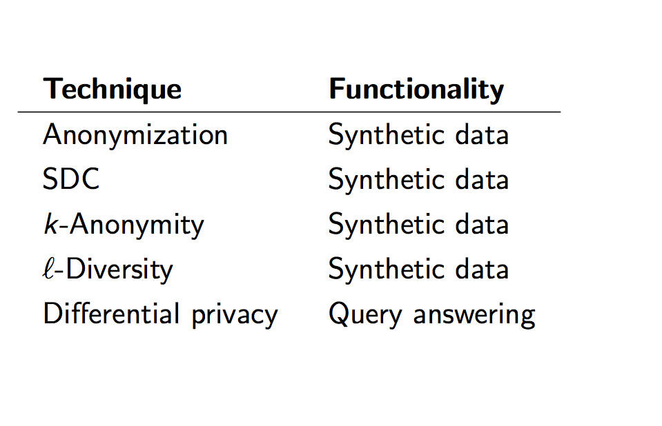
(Data) Privacy Preserving techniques
(primary)
Today
Next week

Slide 16
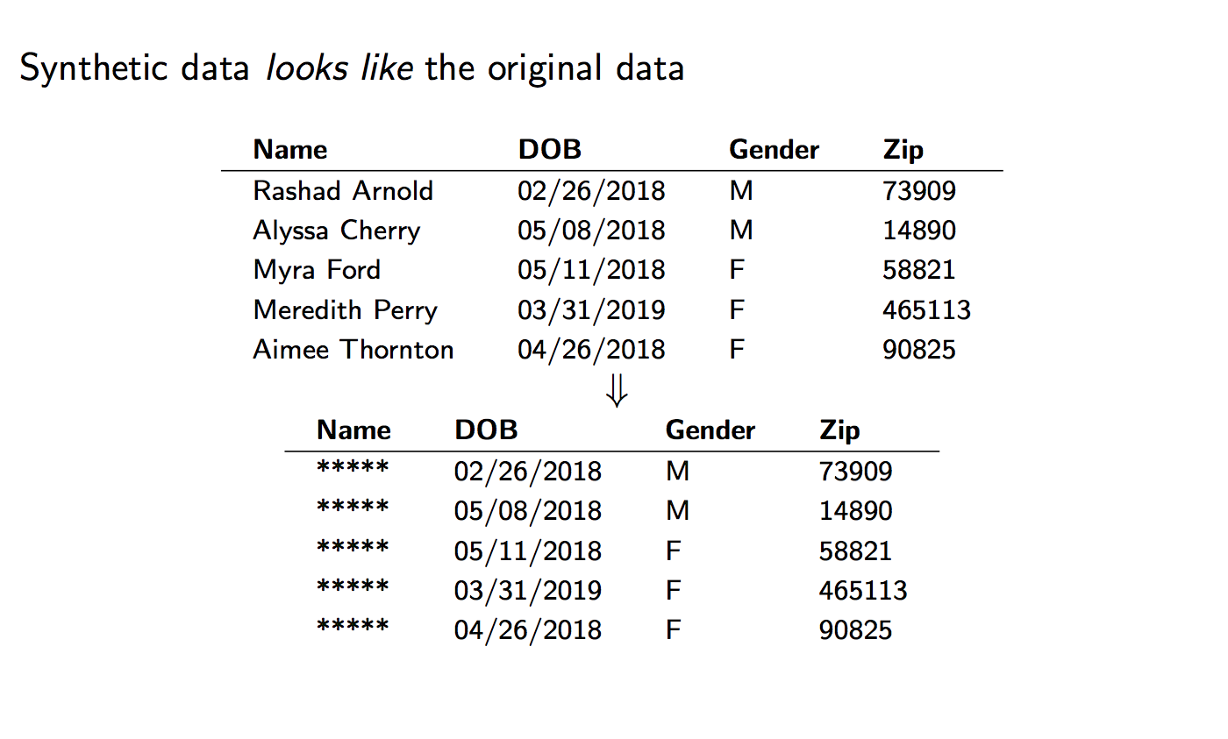
Synthetic data?

Slide 17
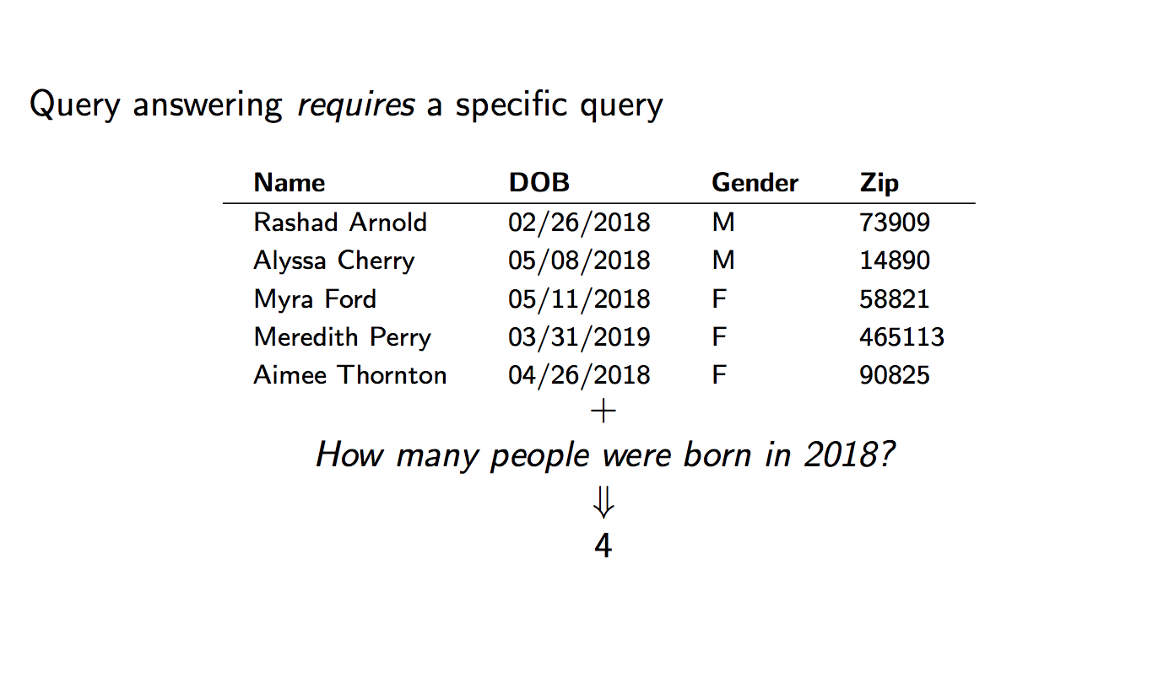
Query answering

Slide 18
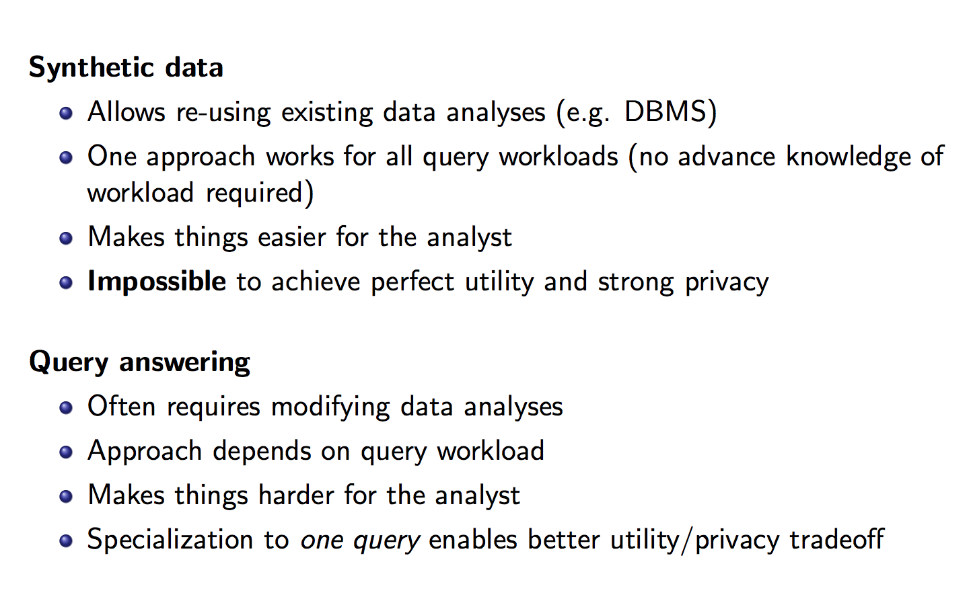
Synthetic data vs. Query Answering

Slide 19
Problems with query answering
Bad vs. Good queries?
Direct and Indirect Queries
Privacy vs. utlity

Slide 20

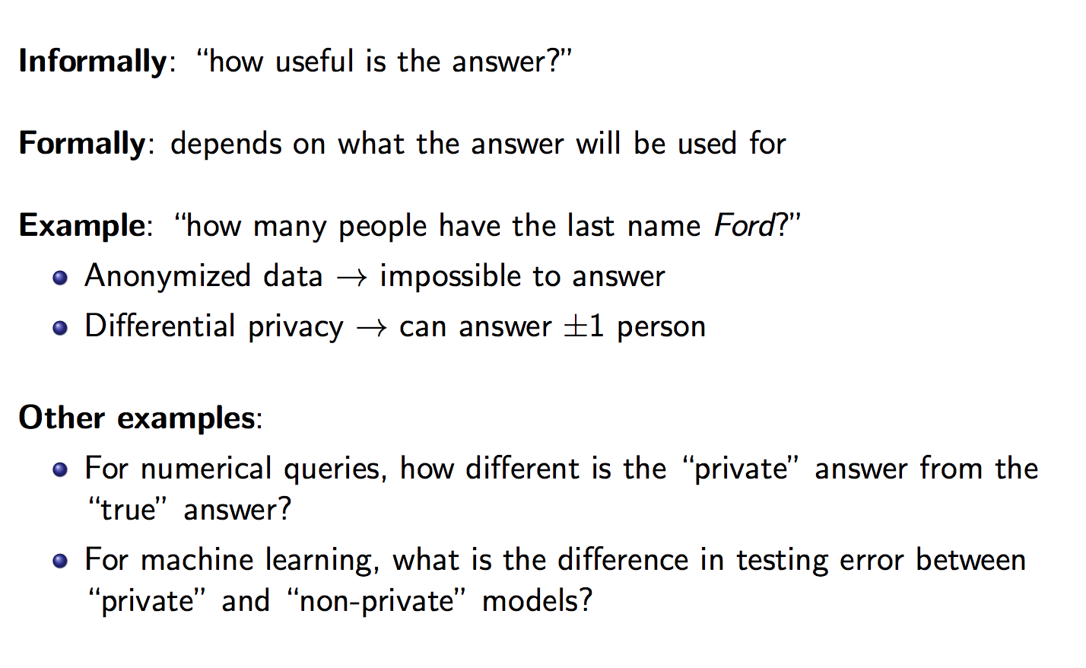


Data Utility

Slide 21
Aside: Privacy is not Security
Data privacy is distinct from data security.
Data security is concerned with who can touch the data:
Confidentiality: ensuring that only the appropriate people can view the data
Integrity: ensuring that only the appropriate people can modify the data
Data privacy is concerned with what can be learned from the data (i.e. its information content)

Slide 22
One common approach to protecting user privacy:
Aggregation

Slide 23
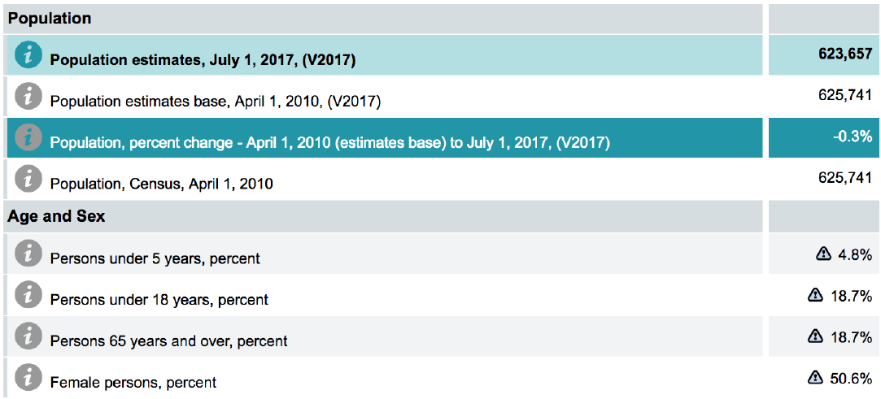
Example – census data.. Poke around yourself
https://www.census.gov/data.html
The US Census protects data privacy via aggregation
*And as of 2020, by DP!...
more later…
The Idea: Grouping participants makes it difficult to learn something specific to any individual

Slide 24
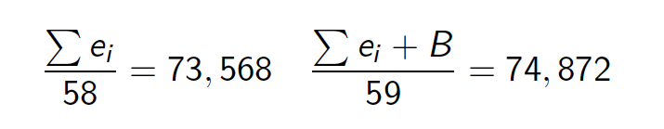
Example: violating privacy over aggregation
A company releases the average salary of its employees each year:
YEAR | AVERAGE SALARY
2018 | $73,568
2019 | $74,872
Auxiliary information:
58 employees in 2018
59 employees in 2019
Your friend Bob was hired between the two releases
→Bob’s Salary…
$150,504

Slide 25
Statistical Disclosure Control
Statistical disclosure control takes a systematic approach to de-identification in order to minimize the risk of re-identification.
Consider:
Likelihood of an attempt at disclosure Impact of disclosure
Auxiliary data available to attackers
Cell values and table design, e.g., counts of 1 or 0 represent high risk
Represents a subjective judgment about risk—no formal guarantee

Slide 26
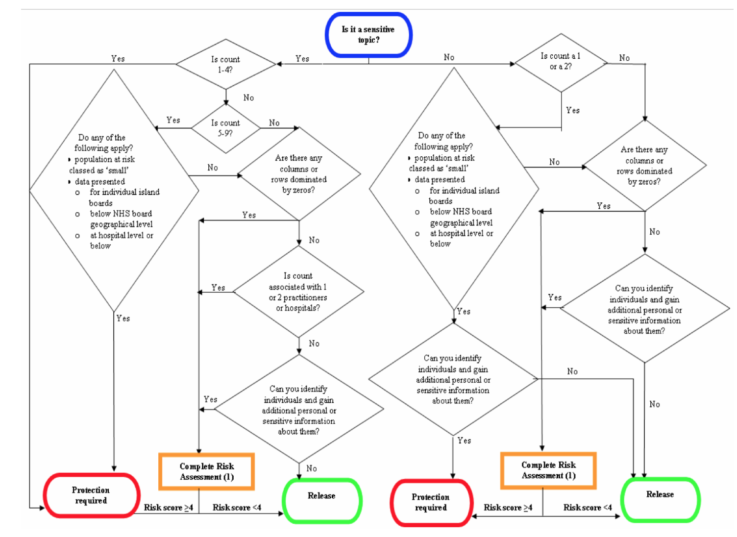
Statistical Data Disclosure

Slide 27
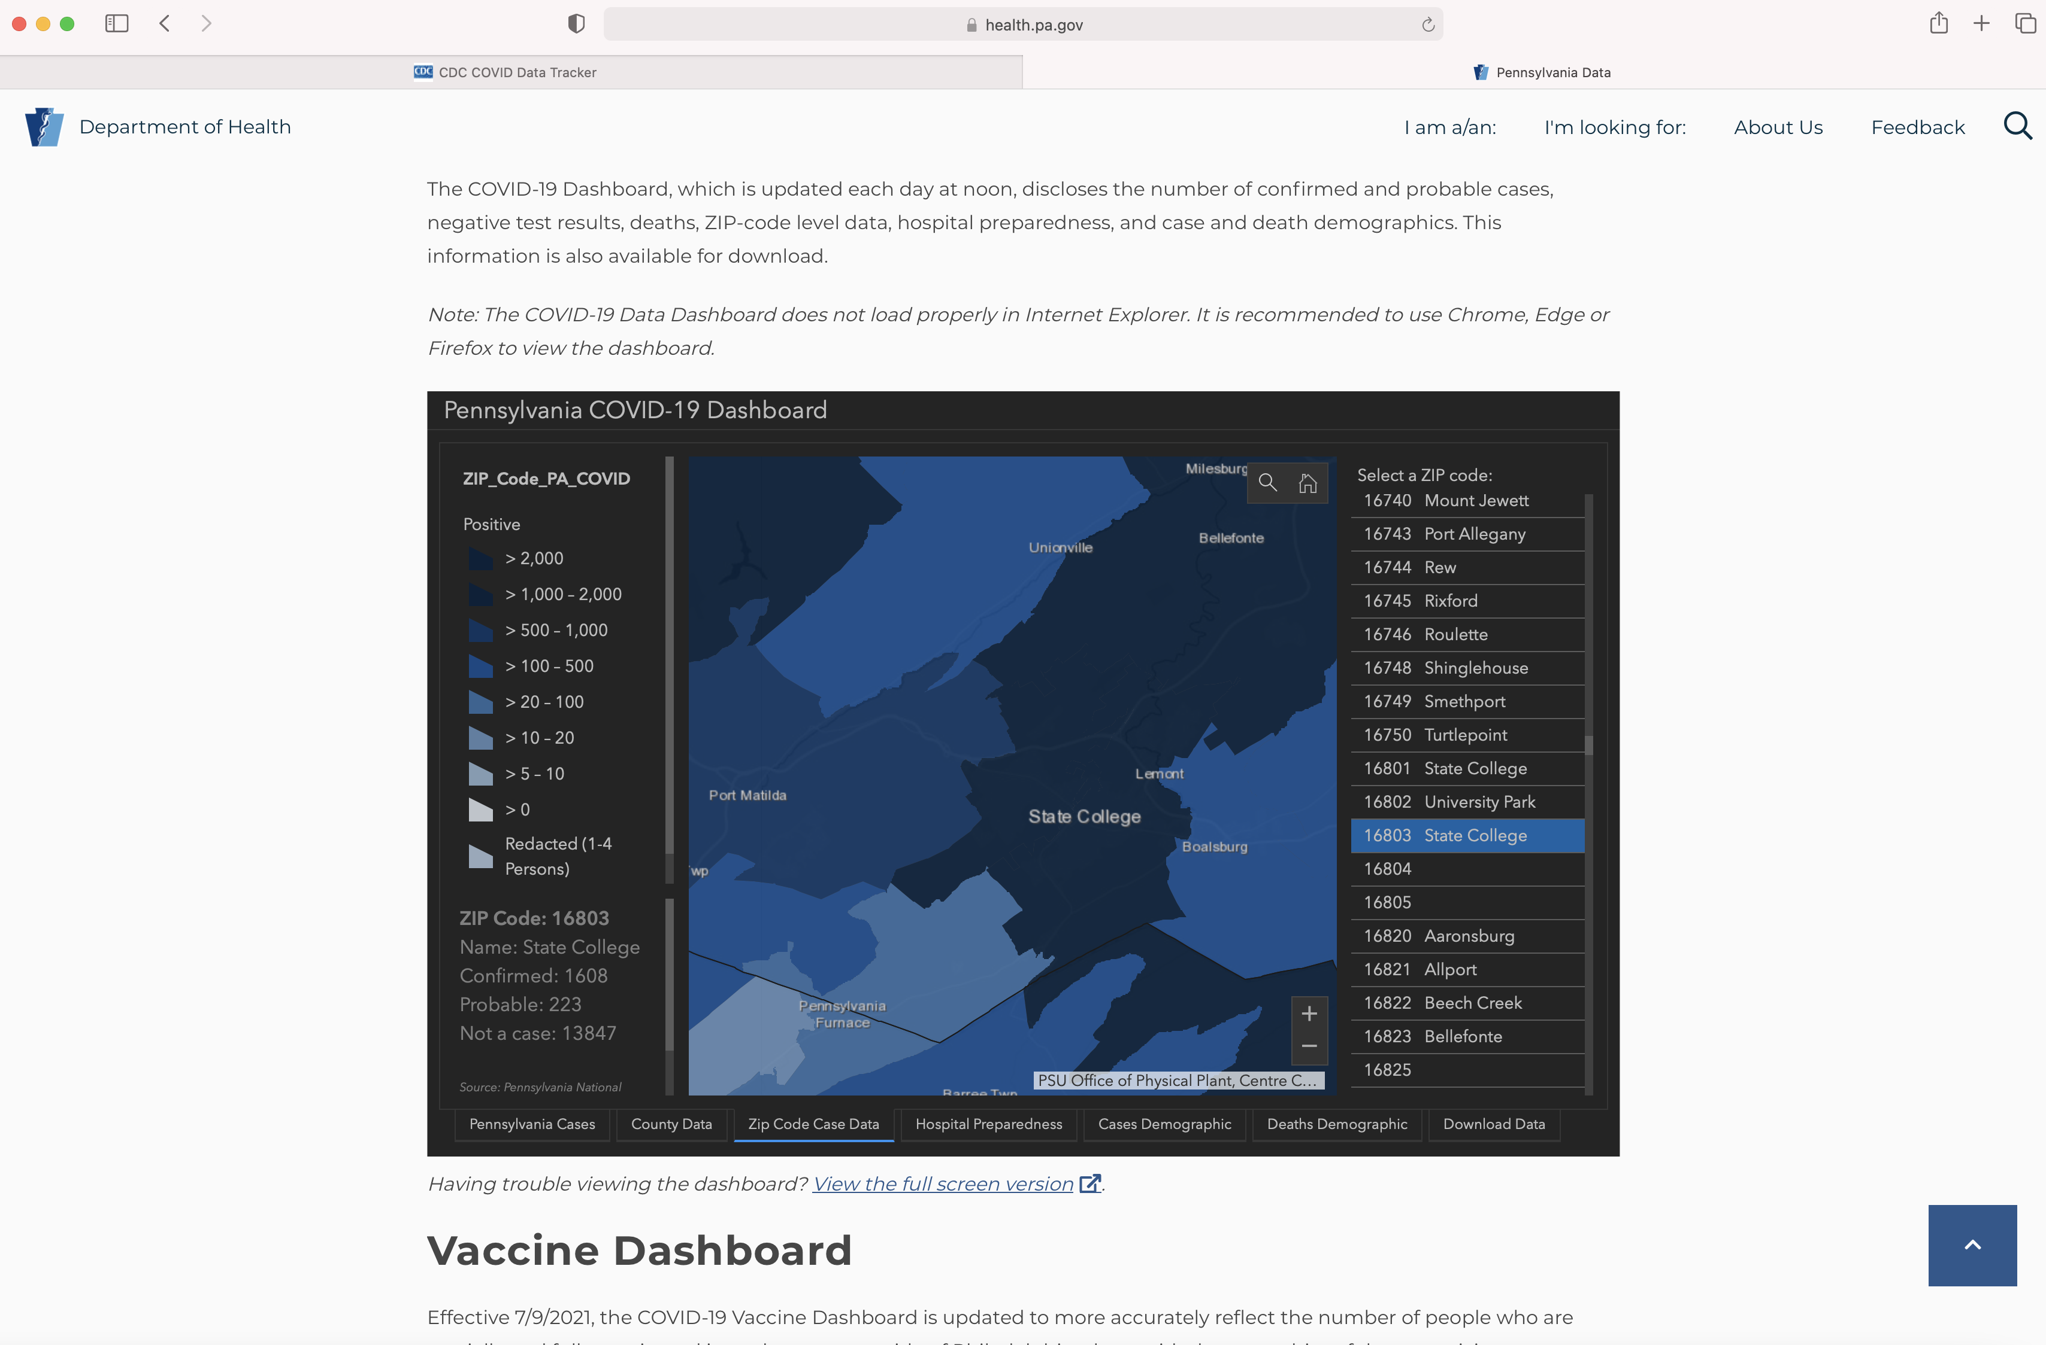
Covid-19 case maps
https://www.health.pa.gov/topics/disease/coronavirus/Pages/Cases.aspx

Slide 28
Anonymizing individual records

Slide 29
Goal: a process which is irreversible and prevents the re-association of a person with a data sample
*impossible to guarantee..

Slide 30


DB anonymization: the model
Q1: whose privacy? what does it mean that “privacy” is not violated?
Q2: who is trusted? what is the adversary model? adversary goal?
third parties the public
background info
Alice
record
Alice
link
background info
Bob
record
Bob
R1
anonymization algorithm
DB holder
anonymized/
sanitized
DB
R2
background info
…
…
R3
Notes:
Q1: the users. The fact that anonymous records cannot be linked back to them

Slide 31
Naïve anonymization
Q1: What is the first thing you would do?
Q2: Is that sufficient? Why (not)?
third parties the public
external
info
Alice
record
Alice
link
external
info
Bob
record
Bob
R1
anonymization algorithm
DB holder
anonymized/
sanitized
DB
R2
external
info
…
…
R3
Notes:
Q1: remove names and unique identifiers
Q2: quasi-identifiers

Slide 32
De-identification
De-identification is a process which removes the association (via personal information) between a person and a Dataset.
Goals:
Reduce risk of privacy violations
Maximize Data Utility
Techniques:
Suppression
Variation
Swap Data items
Masking

Slide 33
Re-identification/Linking

Slide 34
AOL Query Log Release
20 million Web search queries by AOL
AnonID Query QueryTime ItemRank ClickURL
217 lottery 2006-03-01 11:58:51 1 http://www.calottery.com
217 lottery 2006-03-27 14:10:38 1 http://www.calottery.com
1268 gall stones 2006-05-11 02:12:51
1268 gallstones 2006-05-11 02:13:02 1 http://www.niddk.nih.gov
1268 ozark horse blankets 2006-03-01 17:39:28 8 http://www.blanketsnmore.com
(Source: AOL Query Log)

Slide 35
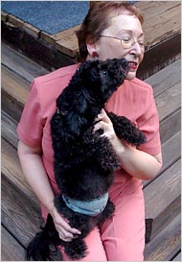
User No. 4417749
User 4417749
“60 single men”
“dog that urinates on everything”
“landscapers in Lilburn, Ga”
Several people names with last name Arnold
“homes sold in shadow lake subdivision gwinnett county georgia”
Thelma Arnold, a 62-year-old widow who lives in Lilburn, Ga., frequently researches her friends’ medical ailments and loves her dogs
Notes:
AOL removed the search data from its site over the weekend and apologized for its release, saying it was an unauthorized move by a team that had hoped it would benefit academic researchers.
35

Slide 36
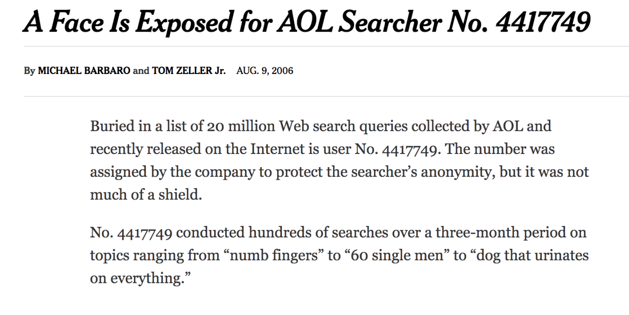
De-identification failure: AOL search logs
Auxiliary data: biographical information (dog ownership, location)

Slide 37
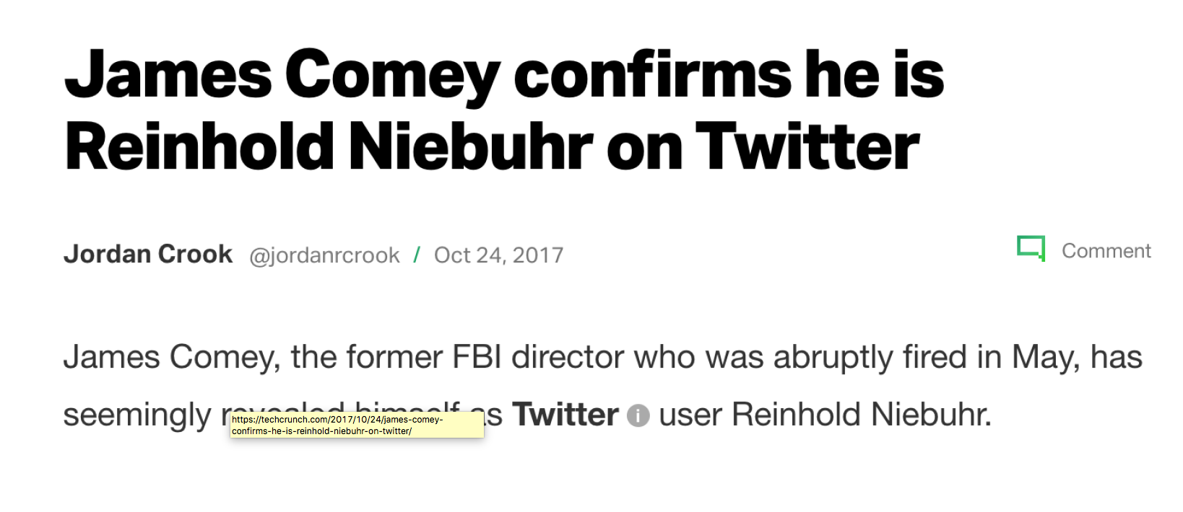
Found him via social graph (Comey's son)
Notes:
https://gizmodo.com/this-is-almost-certainly-james-comey-s-twitter-account-1793843641

Slide 38
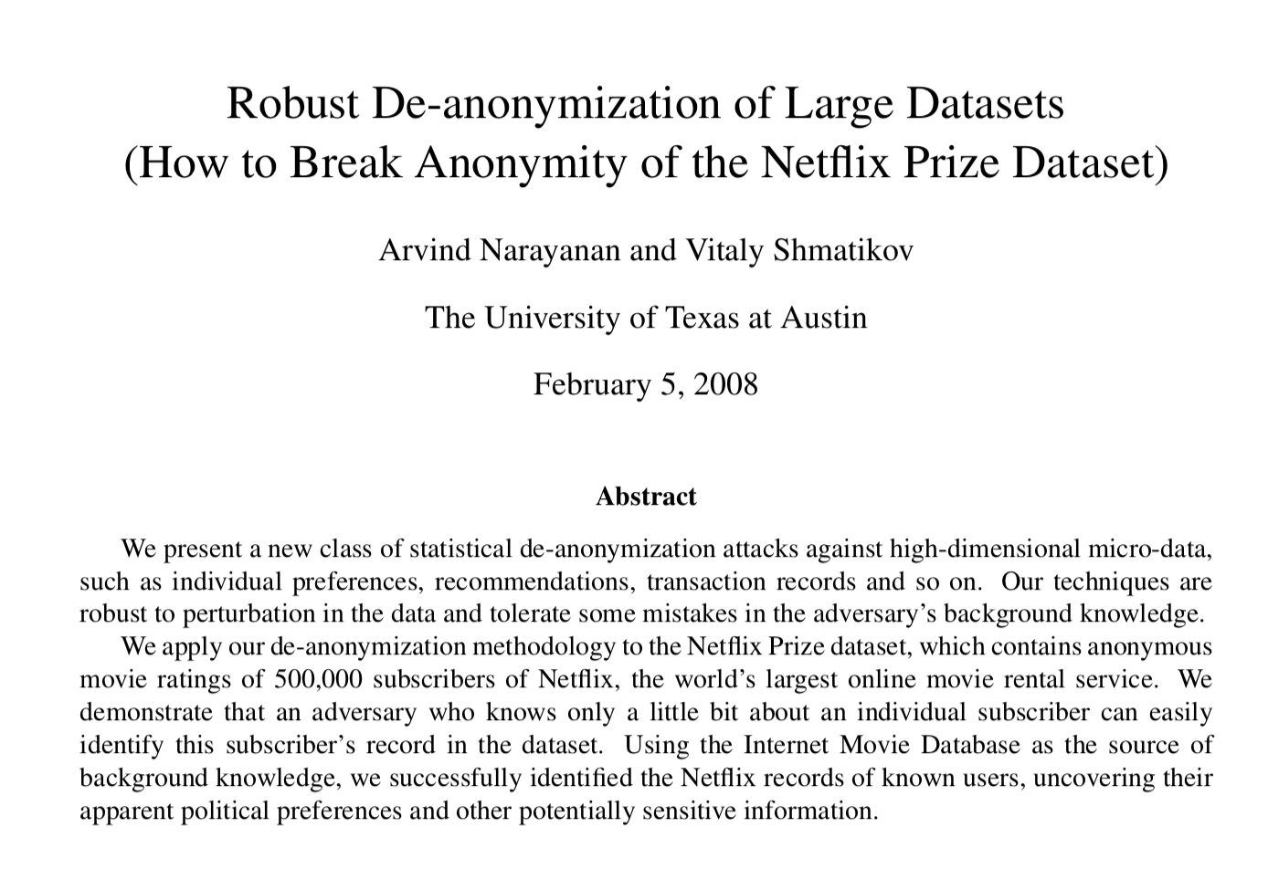


The “Netflix attack”
An adversary with only some background information can re-identify a Netflix subscriber record
Auxiliary data: IMDb ratings (public, many users user their own name)
account
https://www.kaggle.com/netflix-inc/netflix-prize-data
10 million movie rankings
500,000 customers
names replaced by random numbers
What sensitive information?
Notes:
https://arxiv.org/pdf/cs/0610105.pdf

Slide 39
What do those three examples have in common?
How was re-identification possible?

Slide 40
The “Netflix attack”
De-anonymization algorithm
The scoring function assigns a numerical score to each record in DB based on how well it matches the adversary’s auxiliary information Aux (based on similarity of attributes)
The matching criterion is the algorithm applied by the adversary to the set of scores to determine if there is a match.
The record selection selects one “best-guess” record (or a probability distribution).
The scoring function gives higher weight to statistically rare attributes.
To improve robustness (towards errors, incomplete information, or perturbation), the matching criterion requires that the top score be significantly above the second-best score.

Slide 41
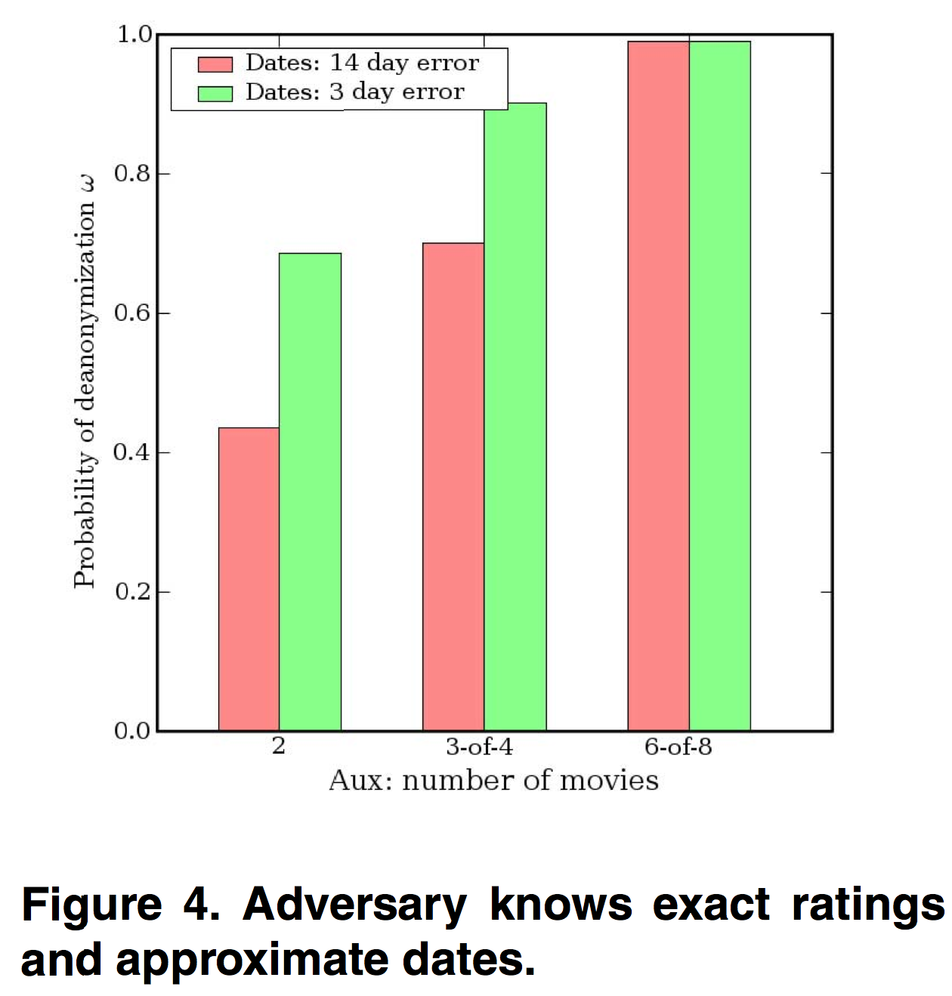
Results Netflix de-anonymization

Slide 42
The “Netflix attack”
Key issue: sparseness of the dataset
think of the dataset as a matrix (rows are individuals, columns are attributes, e.g., movies that can be rated)
sparse: each individual record contains values only for a small fraction of attributes (i.e., most of the values in the matrix are zeros)
Most real-world datasets of individual transactions, preferences, and recommendations are sparse
movies that have been rated, items in Amazon shopping list, etc.
typically: a few “popular” items and a long tail of “rare” items
Privacy breaches:
determining whether an individual is in the dataset if present, then identify set of candidate records (and associated probabilities)
amplification of background knowledge: captures the adversary’s ability to gain information about his target record.
Notes:
The entropy of this distribution can be used as privacy metric (if entropy is too low, we can consider that de-anonymization has succeeded)

Slide 43
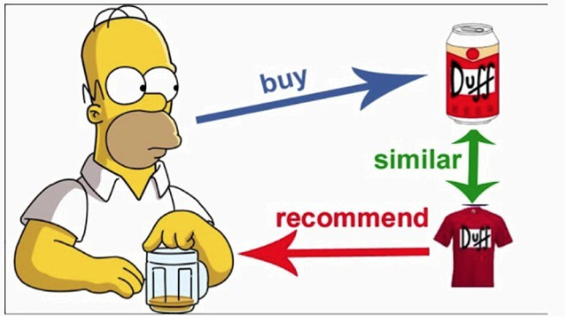
Recommender systems vs. Privacy
Collaborative systems
Use patterns learned from user behavior to make recommendations
Outputs reveal only relationships between items, rather than information about users
Q1: What is considered here the private info (to be protected) and the public info?
Q2: Which property would we want to have?
Q3: What does an “attack” look like?
Notes:
Q1: private: user inputs; public: output of the function: recommendation
Q2: that no private info can be interred from public output, regardless of background information

Slide 44
Recommender systems vs. Privacy
Attack:
Given auxiliary (background) information about a user, infer his individual transactions from temporal changes in the recommendations (public aggregated outputs)
Auxiliary information: public user ratings, Amazon’s verified purchase, tweets, listings of books in Facebook, …
Attack works better for “less conventional” users (no similar users in DB)

Slide 45
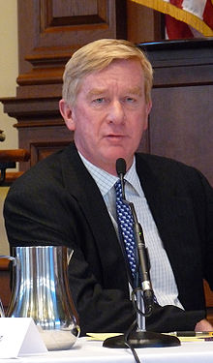
De-identification Failure: Massachusetts GIC Incident
Massachusetts GIC released “anonymized” data on state employees’ hospital visit
Then Governor William Weld assured the public about the data’s privacy
Name | SSN | Age | Zip | Diagnosis
Alice | 123456789 | 44 | 48202 | AIDS
Bob | 323232323 | 44 | 48202 | AIDS
Charley | 232345656 | 44 | 48201 | Asthma
Dave | 333333333 | 55 | 48310 | Asthma
Eva | 666666666 | 55 | 48310 | Diabetes
Age | Zip | Diagnosis
44 | 48202 | AIDS
44 | 48202 | AIDS
44 | 48201 | Asthma
55 | 48310 | Asthma
55 | 48310 | Diabetes
GIC
Anonymized
Notes:
The Massachusetts Group Insurance Commission had a bright idea back in the mid-1990s—it decided to release "anonymized" data on state employees that showed every single hospital visit. The goal was to help researchers, and the state spent time removing all obvious identifiers such as name, address, and Social Security number. But a graduate student in computer science saw a chance to make a point about the limits of anonymization.
At the time GIC released the data, William Weld, then Governor of Massachusetts, assured the public that GIC had protected patient privacy by deleting identifiers.

Slide 46
Then-graduate student Latanya Sweeney linked the data with Voter registration data in Cambridge and identified Governor Weld’s record
Auxiliary data: voter rolls (date of birth, gender, zip code)
Age | Zip | Diagnosis
44 | 48202 | AIDS
44 | 48202 | AIDS
44 | 48201 | Asthma
55 | 48310 | Asthma
55 | 48310 | Diabetes
Name | SSN | Age | Zip | Diagnosis
Alice | 123456789 | 44 | 48202 | AIDS
Bob | 323232323 | 44 | 48202 | AIDS
Charley | 232345656 | 44 | 48201 | Asthma
Dave | 333333333 | 55 | 48310 | Asthma
Eva | 666666666 | 55 | 48310 | Diabetes
Anonymized GIC data
Name | Age | Zip
Alice | 44 | 48202
Charley | 44 | 48201
Dave | 55 | 48310
Voter roll for Cambridge
Notes:
In response, then-graduate student Sweeney started hunting for the Governor’s hospital records in the GIC data. She knew that Governor Weld resided in Cambridge, Massachusetts, a city of 54,000 residents and seven ZIP codes. For twenty dollars, she purchased the complete voter rolls from the city of Cambridge, a database containing, among other things, the name, address, ZIP code, birth date, and sex of every voter. By combining this data with the GIC records, Sweeney found Governor Weld with ease. Only six people in Cambridge shared his birth date, only three of them men, and of them, only he lived in his ZIP code. In a theatrical flourish, Dr. Sweeney sent the Governor’s health records (which included diagnoses and prescriptions) to his office.

Slide 47
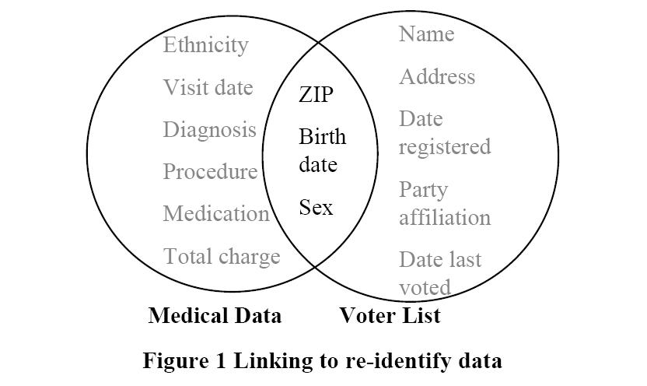
Re-identification

Slide 48
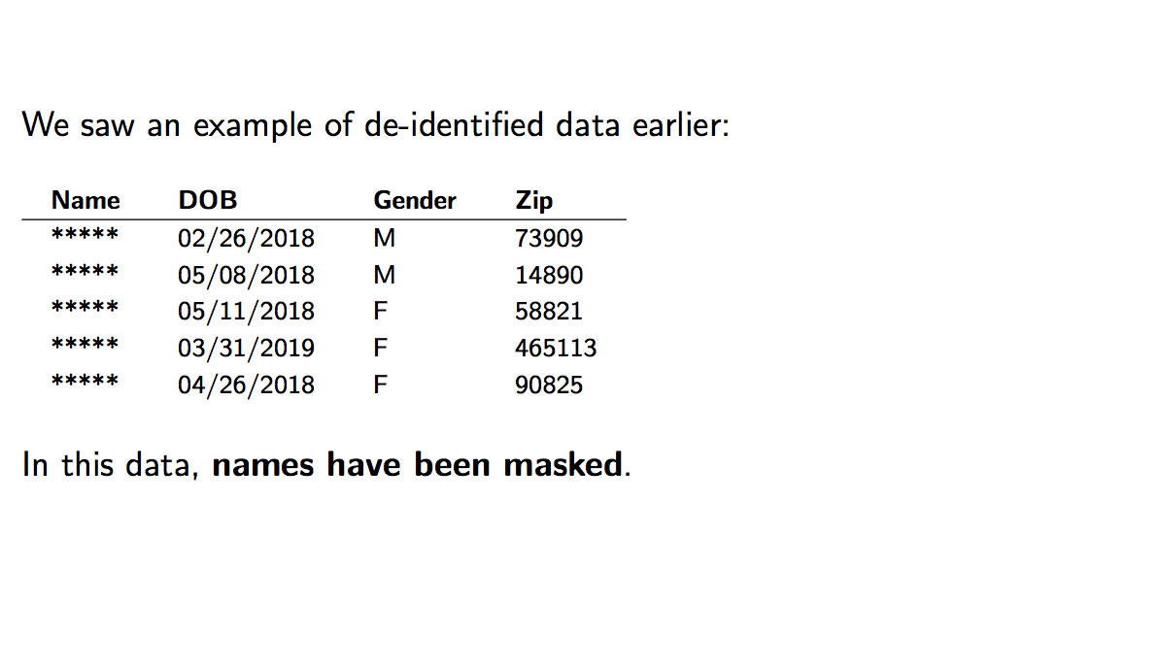
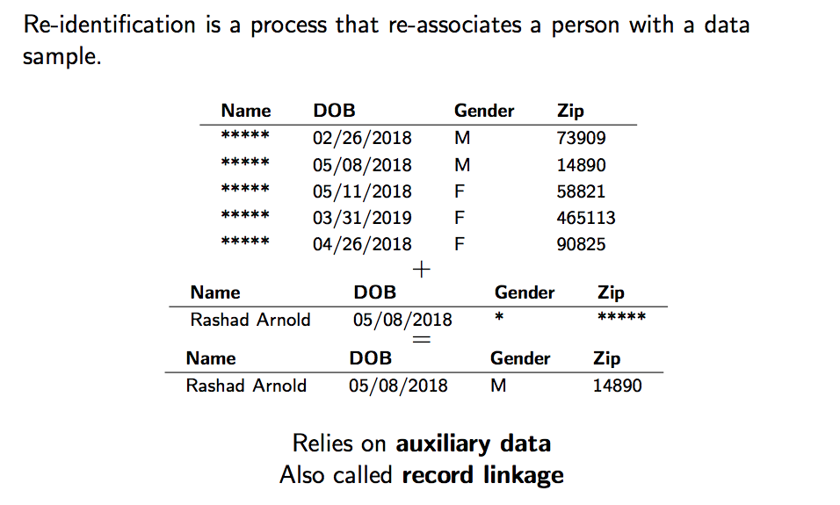
Consider this example:

Slide 49
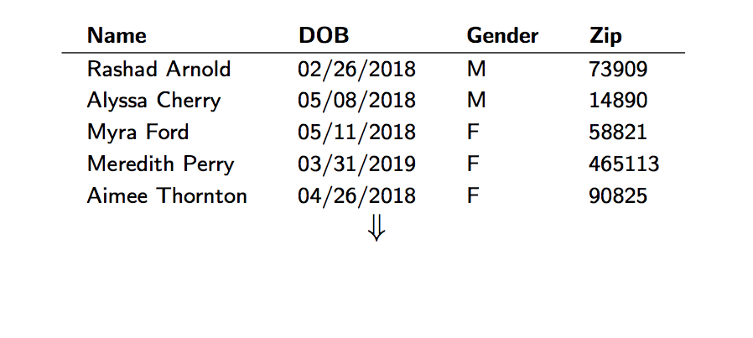
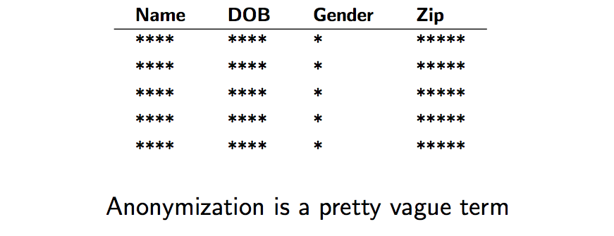
Anonymization
Privacy guarantee
Data utility/
Model accuracy

Slide 50
Aggregation doesn't necessarily protect individual privacy.
Anonymization doesn't necessarily protect individual privacy.
Large datasets (i.e., large populations) don't necessarily protect individual privacy.
Machine learning doesn't necessarily protect individual privacy.
Challenge: Tension between accuracy and privacy

Slide 51
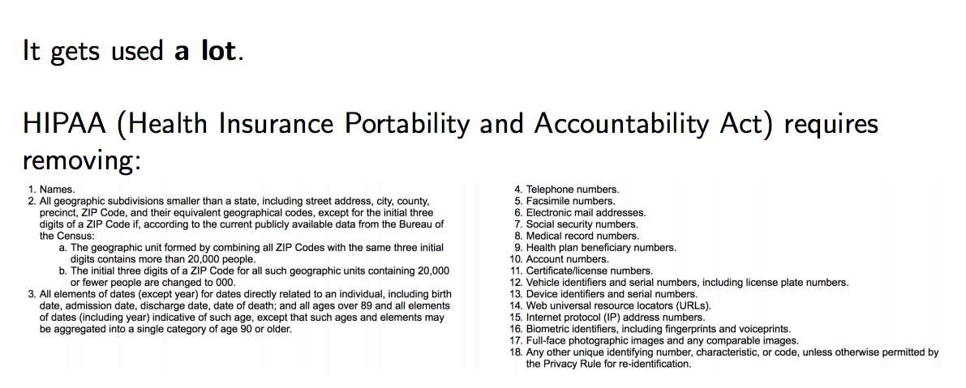
Anonymization: why should we care?

Slide 52
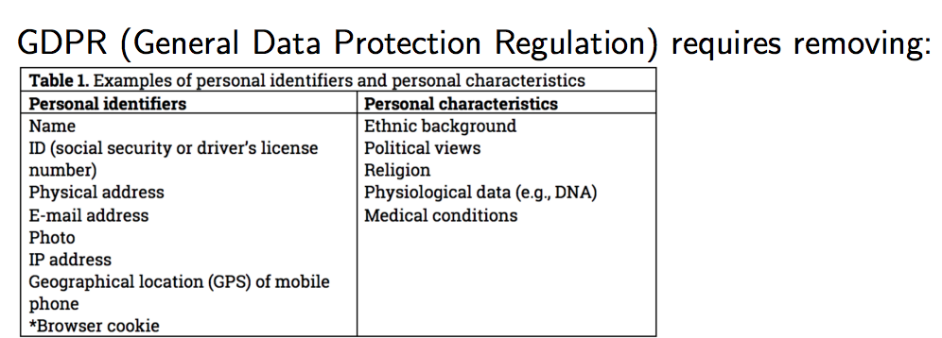
Anonymization: why should we care?
These identifiers are called personally identifiable information (PII).
Removing PII makes re-identification harder
Removing PII does not make re-identification impossible (hence, PII is another vague term)

Slide 53
Hands-on activity!
Head to https://mybinder.org
From there, launch https://github.com/SarahRajtmajer/DataPrivacy_Spring2022
From there,
Open “Re-identification.ipynb”

Slide 54
Break (& post to discussion)

Slide 55
Seems like re-identification is an important concern… What else can we do?
Data use agreements
Access control restrictions
Audits
More systematic approach to making data private

Slide 56
Toward some more formal guarantees…

Slide 57
Presentation

Slide 58
Motivating Example
 | Non-Sensitive Data |  |  | Sensitive Data
# | Zip | Age | Nationality | Name | Condition
1 | 13053 | 28 | Brazilian | Ronaldo | Heart Disease
2 | 13067 | 29 | US | Bob | Heart Disease
3 | 13053 | 37 | Indian | Kumar | Cancer
4 | 13067 | 36 | Japanese | Umeko | Cancer
⑤
Modify
Data
①
Notes:
Alice wants to publish hospital data, while the correspondence between name & disease stays private

Slide 59
Published Data: Alice publishes data without the Name
 | Non-Sensitive Data |  |  | Sensitive Data
# | Zip | Age | Nationality | Condition
1 | 13053 | 28 | Brazilian | Heart Disease
2 | 13067 | 29 | US | Heart Disease
3 | 13053 | 37 | Indian | Cancer
4 | 13067 | 36 | Japanese | Cancer
⑤
Modify
Data
①
Attacker’s Knowledge: Voter registration list
#
Name
Zip
Age
Nationality
1
John
13067
45
US
2
Paul
13067
22
US
3
Bob
13067
29
US
4
Chris
13067
23
US
Notes:
In general the attacker can use “external knowledge” which could be some prior knowledge instead of some other data source

Slide 60
Published Data: Alice publishes data without the Name
 | Non-Sensitive Data |  |  | Sensitive Data
# | Zip | Age | Nationality | Condition
1 | 13053 | 28 | Brazilian | Heart Disease
2 | 13067 | 29 | US | Heart Disease
3 | 13053 | 37 | Indian | Cancer
4 | 13067 | 36 | Japanese | Cancer
⑤
Modify
Data
①
Attacker’s Knowledge: Voter registration list
# | Name | Zip | Age | Nationality
1 | John | 13067 | 45 | US
2 | Paul | 13067 | 22 | US
3 | Bob | 13067 | 29 | US
4 | Chris | 13067 | 23 | US
Data Leak !
Notes:
We assume that the attacker knows that Bob’s medical data are in the hospital database

Slide 61
Source of the Problem
Even if we do not publish the identifiers: There are some fields that, together, may uniquely identify some individual
 | Non-Sensitive Data |  |  | Sensitive Data
# | Zip | Age | Nationality | Condition
… | … | … | … | …
Quasi Identifier
The attacker can use them to join with other sources to identify individuals.
Notes:
Make clear that the quasi identifier might not be a PK – it is used for joining

Slide 62
Attribute Classification
I₁, I₂,..., I_{m} - identifier attributes
Ex: Name and SSN
Information that leads to a specific entity.
K₁, K₂,.…, K_{p} - key attributes (quasi-identifiers)
Ex: Zip Code and Age
May be known by an intruder.
S₁, S₂,.…, S_{q} - confidential attributes
Ex: Principal Diagnosis and Annual Income
Assumed to be unknown to an intruder.

Slide 63
Attribute Types
Identifier, Key (Quasi-Identifiers) and Confidential Attributes
RecID | Name | SSN | Age | State | Diagnosis | Income | Billing
1 | John Wayne | 123456789 | 44 | MI | AIDS | 45,500 | 1,200
2 | Mary Gore | 323232323 | 44 | MI | Asthma | 37,900 | 2,500
3 | John Banks | 232345656 | 55 | MI | AIDS | 67,000 | 3,000
4 | Jesse Casey | 333333333 | 44 | MI | Asthma | 21,000 | 1,000
5 | Jack Stone | 444444444 | 55 | MI | Asthma | 90,000 | 900
6 | Mike Kopi | 666666666 | 45 | MI | Diabetes | 48,000 | 750
7 | Angela Simms | 777777777 | 25 | IN | Diabetes | 49,000 | 1,200
8 | Nike Wood | 888888888 | 35 | MI | AIDS | 66,000 | 2,200
9 | Mikhail Aaron | 999999999 | 55 | MI | AIDS | 69,000 | 4,200
10 | Sam Pall | 100000000 | 45 | MI | Tuberculosis | 34,000 | 3,100

Slide 64
Introduction to k-Anonymity
The k-anonymity property for a masked microdata (MM) is satisfied if with respect to a quasi-identifier set (QID) if every count in the frequency set of MM with respect to QID is greater or equal to k.

Slide 65
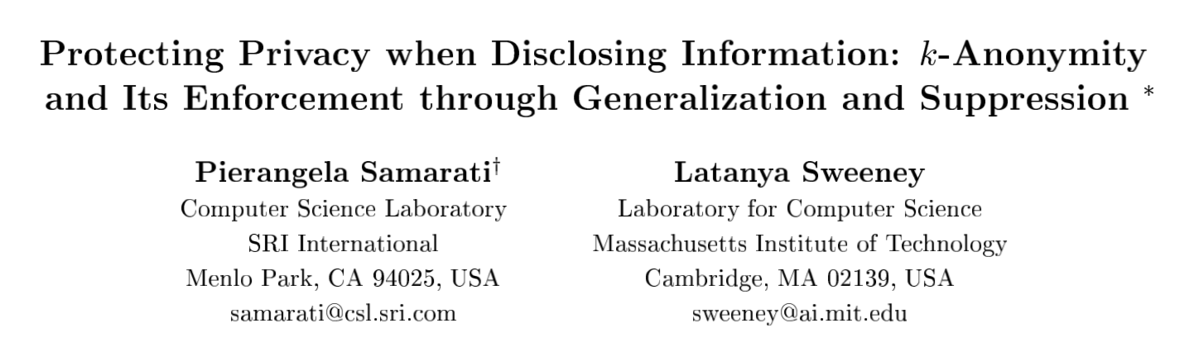
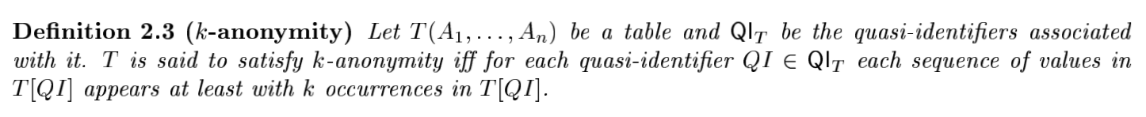
Defining k-anonymity

Slide 66
Check for k-Anonymity
RecID | Age | Zip | Sex | Illness
1 | 50 | 41076 | Male | AIDS
2 | 30 | 41076 | Female | Asthma
3 | 30 | 41076 | Female | AIDS
4 | 20 | 41076 | Male | Asthma
5 | 20 | 41076 | Male | Asthma
6 | 50 | 41076 | Male | Diabetes
QID = { Age, Zip, Sex }
SELECT COUNT(*) FROM Patient GROUP BY Sex, Zip, Age;
If the results include groups with count less than k, the relation Patient does not have k-anonymity property with respect to QID.
This dataset is k-anonymous for what value of k?

Slide 67
How to achieve it? Next week…

Slide 68
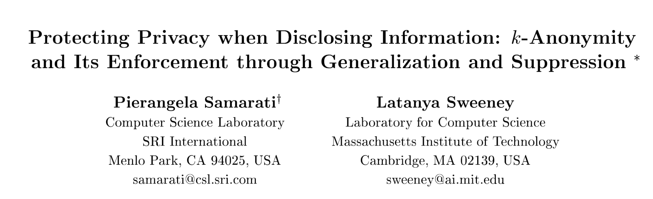
For next Monday (on Zoom!)
Please read:
(posted on Canvas)
Thank you!

